Slide 1

US Housing Market Status
Jorge Duran
Nov 2022

Slide 2
Introduction
In the following months after the Covid-19 pandemic hit in March 2020, the housing market experienced shortages of houses due to construction materials and labor issues.
A lot of people that were planning on buying their house were put on hold and are just now resuming their plans. This analysis was made to give them a high-level status on the housing market condition.
Data for this analysis was obtained from the US Census website (residential constructions).

Slide 3
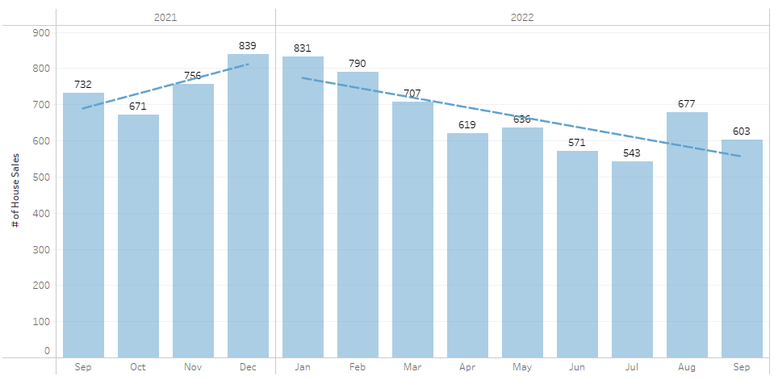
How are house sales in the US?
There has been a 28% decline in house sales in 2022
*House sales units expressed in thousands.

Slide 4
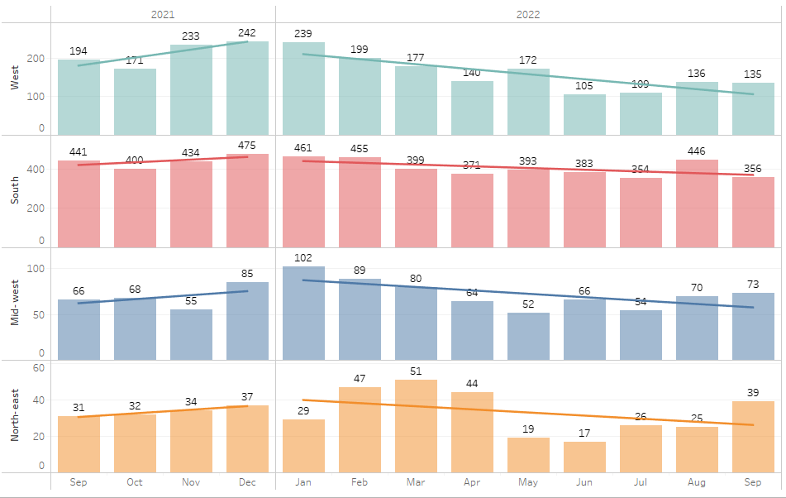
Is this downtrend similar for all regions?
43%
23%
All regions have seen the same downtrend in 2022 but is more evident in the West coast.
28%
26%
*House sales units expressed in thousands.

Slide 5
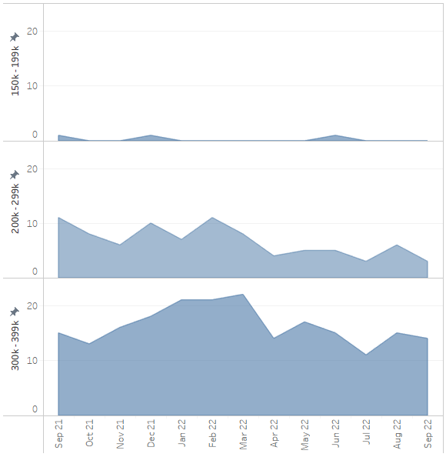
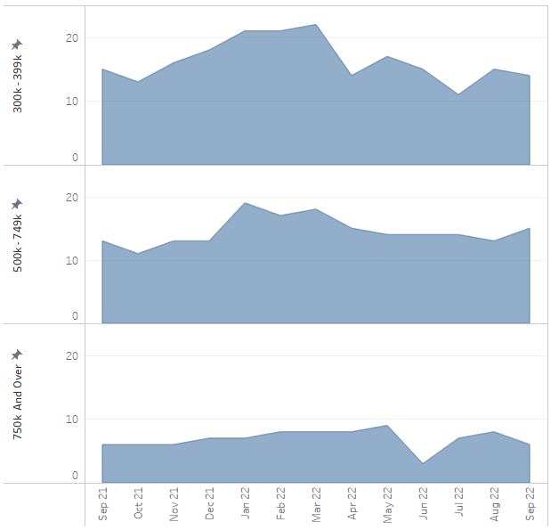
House sales based on price range
House sales with prices lower than $750k seem to also be following the same downtrend in 2022.
*House sales units expressed in thousands.

Slide 6
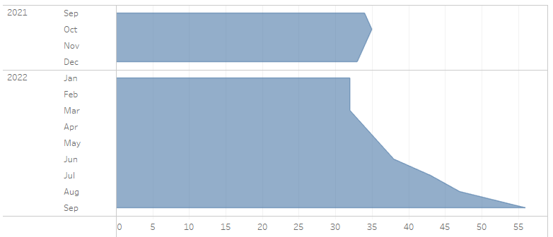
Is house inventory still a problem?
The number of completed houses for sale has incremented and it's at its highest level in the last year.
Due to high interest rates for home loans, many home buyers are not able to purchase houses anymore.
*House sales units expressed in thousands.

Slide 7
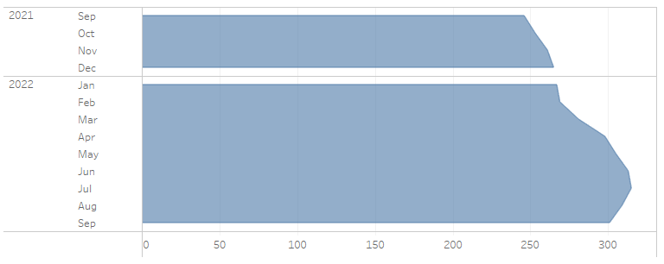
Are new houses being constructed?
New house construction seems to have slowed down due to low demand.
*House sales units expressed in thousands.

Slide 8
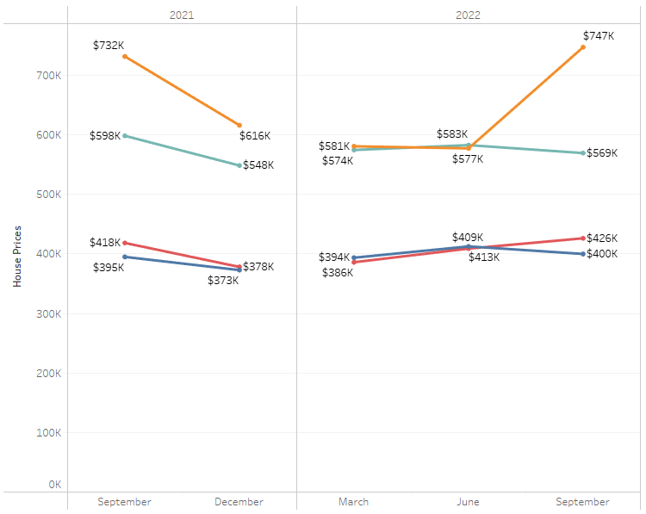

House price median by region
Northeast region had a decline in prices at the end of 2021, but prices have come back to Sept 2021 levels.
Prices for other regions seem to have fluctuated within the year but remain very close to Sept 2021 levels.

Slide 9
Conclusion
House sales are declining across all US regions, especially the West.
House inventory was a problem some months ago, but more houses are in inventory now.
New house construction is declining, most likely due to low demand.
Prices seem to be in the same ranges as a year ago (Sept 2021).

Slide 10
References
Data used for this analysis was obtained from the US Census website.
New Residential Sales
https://www.census.gov/construction/nrs/index.html
https://www.census.gov/construction/nrs/xls/newressales.xls
https://www.census.gov/construction/nrs/xls/quarterly_sales_cust.xls

